Slide 1
Efficiency for Particles
Dr. Jacob Moore
Associate Professor of Engineering
Penn State Mont Alto

Slide 2
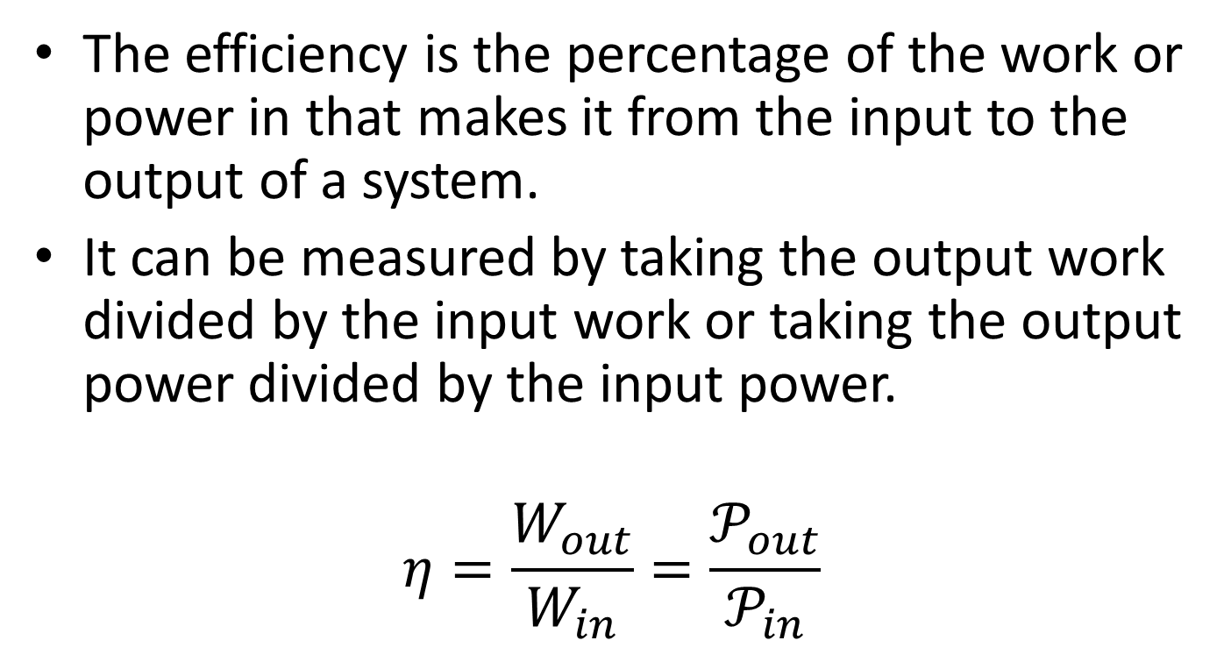
Efficiency
The efficiency is the percentage of the work or power in that makes it from the input to the output of a system.
It can be measured by taking the output work divided by the input work or taking the output power divided by the input power.
$$η=\frac{W_{out}}{W_{in}}=\frac{𝒫_{out}}{𝒫_{in}}$$

Slide 3
Thanks for Watching
See other engineering mechanics videos and access the full tool at…

